Slide 1

📘 RetailNexus_Corp Sales Insight & Forecasting Report
Created by
Ibrahim Ajiboro
1

Slide 2







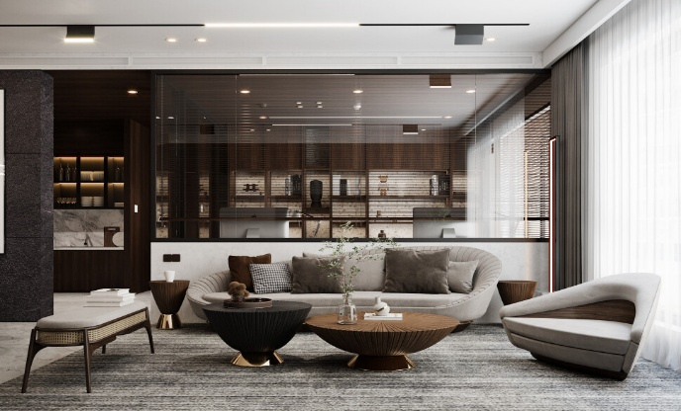

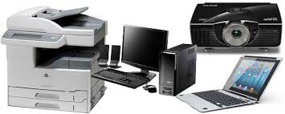
The regions we have expanded to over the years…
Regions
Central
East
South
West
The customers we serve…
Segments
Consumer
Corporate
Home Office
The items we sell…
Categories
Furniture
Office Supplies
Technology
2

Slide 3

Total estimate of sales we have made each year from 2016 to 2019 ..
“Overall sales increased 51.5% over the 4-year period”
733k
609k
484k
470k
West
East
South
Central
2016
2017
2018
2019
3

Slide 4
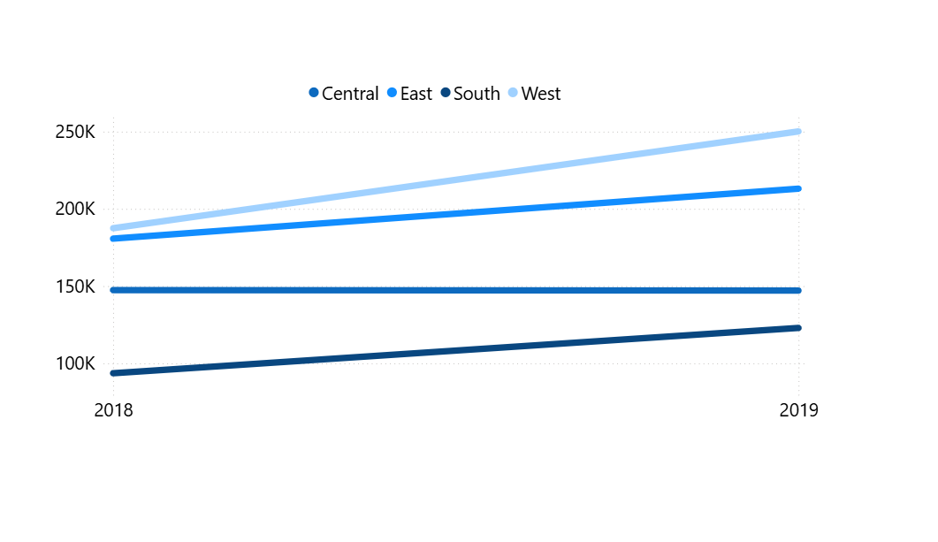
In 2019, the standout performers were the West and South regions, recording strong YoY growth of +33.4% and +31.3%, respectively. The East region also showed healthy expansion at +17.9%. In contrast, the Central region experienced a marginal decline of −0.22%, raising questions about potential market saturation or internal operational shifts.”
 | 2018 | 2019 | %_diff
West | 187480.18 | 250128.37 | +33.42
East | 180685.82 | 213082.90 | + 17.93
Central | 147429.38 | 147098.13 | -0.22
South | 93610.22 | 122905.86 | +31.30
To understand the underlying drivers of Central’s stagnation, the upcoming slides will drill down into regional segments and product categories. This layered investigation aims to reveal whether performance bottlenecks stem from segment-specific behaviour, product preference shifts, or competitive dynamics within the Central region.”
4

Slide 5
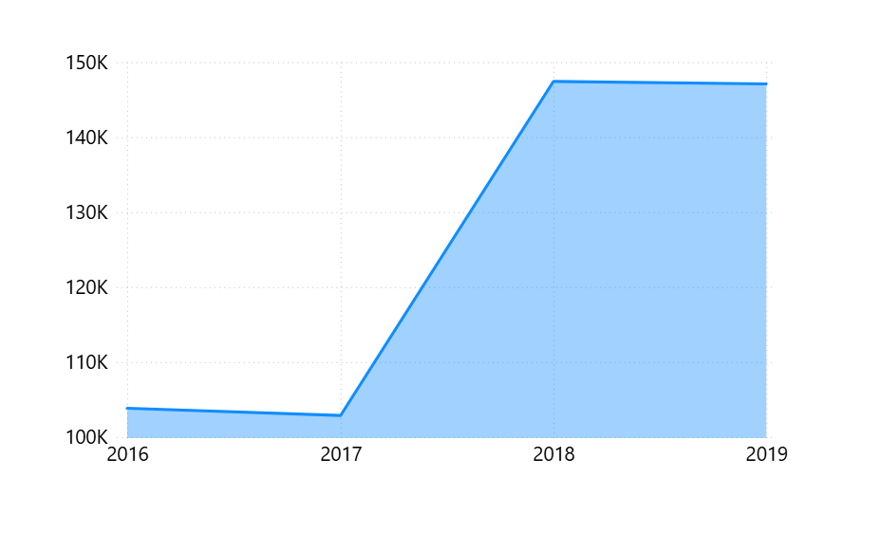
 | 2019 | %_diff
2016 | 103.84k | --
2017 | 102.87k | - 0.93%
2018 | 147.42k | + 43.3%
2019 | 147.09k | - 0.22%
The chart above visualizes the Central region's yearly sales performance from 2016 to 2019. As seen:
a. Sales remained virtually flat between 2016 and 2017, dipping slightly from $103.8k to $102.9k (-0.93%).
b. In 2018, Central saw a substantial boost of +43.3%, rising sharply to $147.4k — a peak year.
c. However, momentum stalled in 2019, with a minor decline to $147.1k (-0.22%), indicating a plateau after the previous year's gains.
This noticeable plateau in 2019, despite the major growth in 2018, raises important questions:
a. What drove the 2018 success?
b. Why couldn’t Central sustain that growth in 2019?
To address these, the next slides will zoom into the composition of sales within Central — exploring:
a. Segments (Consumer, Corporate, Home Office) to identify buyer behaviour shifts.
b. Categories (Furniture, Office Supplies, Technology) to uncover product-level performance bottlenecks.
5

Slide 6
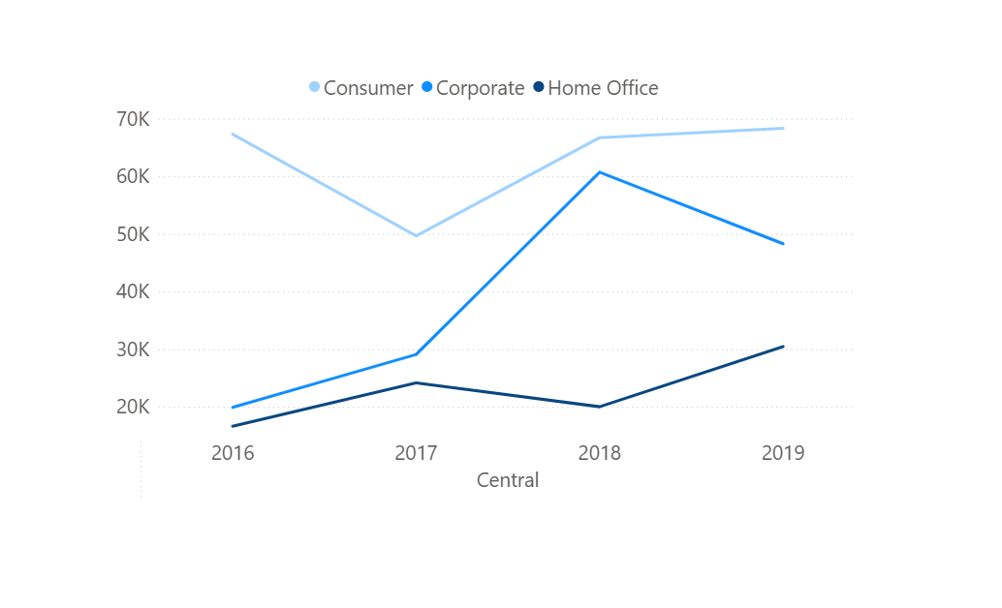
The Consumer segment, traditionally the strongest in Central, peaked early around 2016, dipped in 2017, and then recovered. However, its growth has plateaued, ending 2019 at nearly the same level as 2016. This stagnation suggests possible market saturation or lack of renewed customer engagement in the B2C space.
The Corporate segment emerged as a key growth driver, with sales accelerating sharply from 2016 to 2018. However, this momentum was not sustained into 2019, showing a decline. This drop may indicate either budget constraints, policy shifts, or contract expirations among B2B clients.
The Home Office segment showed modest but steady growth across the years, with a slight dip in 2018 but recovery in 2019. While not a major contributor to Central’s total sales, it remains a reliable base — potentially promising if product targeting improves.
6

Slide 7
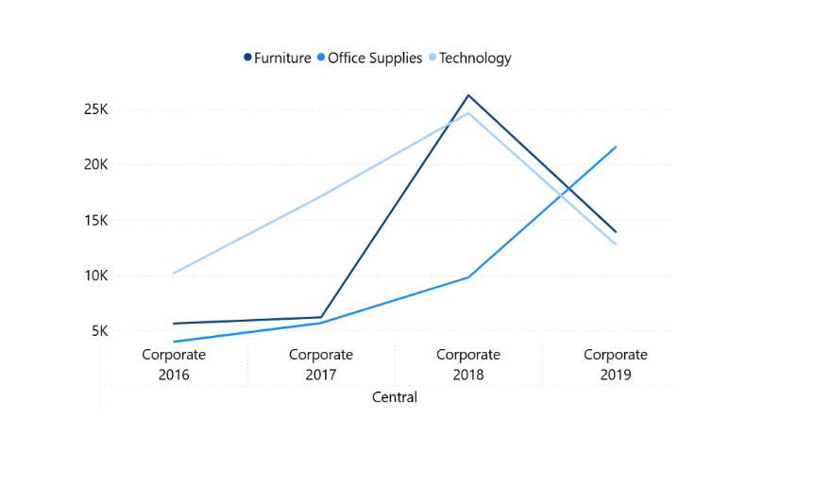
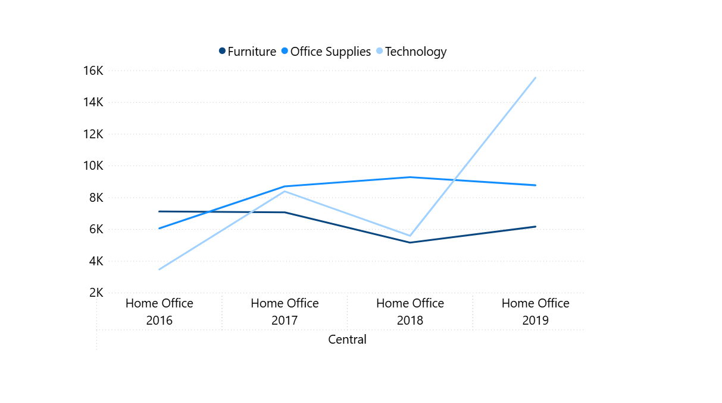
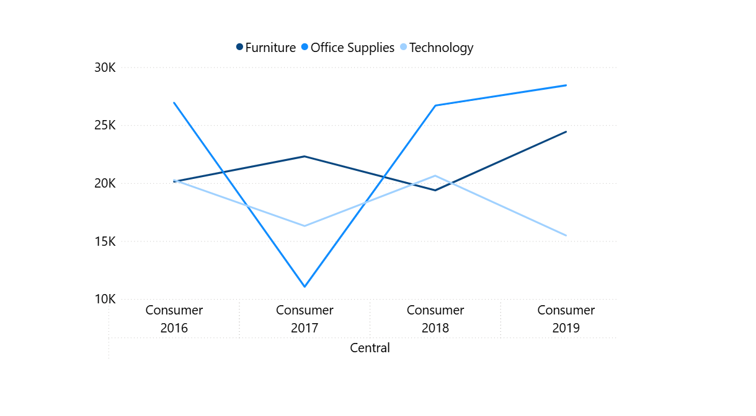
The sudden rise and drop in Technology sales within Corporate clients may explain the regional spike in 2018 and the plateau in 2019. This suggests a dependency on capital-intensive purchases that are not annually repeated.
Home Office category purchases show slow but stable growth, with Furniture leading. The absence of sharp drops or surges may indicate a mature and consistent buyer behavior in this segment.
The rise in Furniture and dip in Technology for Consumers in Central might indicate a post-digital adoption stabilization where consumers now prefer tangible comfort upgrades over tech refresh cycles.
7

Slide 8
Summary of Key Findings
Over the course of our analysis from 2016 to 2019, our exploration has revealed the following:
📍 Regional Highlights:
Segment Analysis in Central:
📦 Category-Specific Observations:
West and South delivered standout performances in 2019, with YoY growth of +33.4% and +31.3% respectively.
Central showed early growth (2016–2018) but plateaued in 2019, with a slight drop of -0.22%, indicating potential saturation or emerging inefficiencies.
Corporate segment grew sharply in 2018 but declined in 2019, driven by a dip in Technology sales.
Home Office segment showed slow but consistent growth across all categories.
Consumer was relatively stable but may require product re-alignment.
Furniture remains stable and strong across segments.
Technology shows volatility—suggesting changing customer demands or supply challenges.
Office Supplies maintained mid-level consistency but lacks momentum.
📈 Overall Growth:
Total company sales rose significantly — from 484k in 2016 to 733k in 2019, a +51% increase.
8

Slide 9
Strategic Recommendations
For Operations & Sales Managers:
📣 For Marketing & Product Teams:
Double Down on High-Performing Regions:
💼 For Executive Leadership (CEO, Board)
Re-evaluate Central Region Strategy:
Consider market saturation, pricing, or operational bottlenecks.
Commission regional market research or internal performance audits.
Champion Predictive Analytics:
Forecasting 2020 trends at segment + category level will increase agility in supply and marketing decisions.
Leverage successful playbooks from West & South.
Allocate promotional and resource budgets accordingly.
Stabilize Corporate Segment in Central:
Investigate B2B pricing, competitor influence, or seasonal anomalies.
Introduce tech product bundles or loyalty strategies to reverse the dip.
Refocus Consumer-Tech Products:
Identify declining SKUs and align with trending tech needs (e.g., remote work tools).
Strengthen Emerging Segments:
Nurture Home Office growth with targeted messaging and bundled deals.
9

Slide 10

Closing Remark
As your data science consulting partner, we’ve not only highlighted what has happened, but also why it happened and where to go next. See you in the brighter future.
10

Slide 11


